Slide 1

An AI Enabled System for Road Sign Detection & Classification
PROJECT ID (PCSE25-17)
Outcome of the Project : Research Paper
Project Outcomes
Sustainable Development Goals Mapping
Engineering knowledge
Design/development of solutions
Conduct investigations of complex problems
Modern tool usage
Problem analysis
Ability to analyze, design, develop, test, and manage complex software & hybrid applications
SDG 3: Good Health and Well-being
SDG 4: Quality Education
The project improves road safety with real-time sign detection and speech output, helping drivers stay focused and reduce distractions.
The project serves as an educational tool, teaching AI, object detection, and their real-world applications, highlighting AI's social impact.
SDG 9: Industry, Innovation, and Infrastructure
SDG 11: Sustainable Cities and Communities
This project leverages AI and machine learning to support smart city initiatives, making transportation safer and more efficient.
The project supports sustainable urban mobility by enabling reliable road sign recognition, aiding autonomous vehicles, and improving safety in smart cities.
PROJECT ID (PCSE25-17)
Khushi Agnihotri Divyansh Goel Devansh Vashistha Naman Yadav
PCSE25-17

Slide 2
Project Abstract
Overview
Key Objectives
Approach
This project develops an AI-powered Road Sign Detection and Classification system using YOLO, and Google Text-to-Speech, providing real-time visual and auditory alerts to enhance safety and driver awareness.
The objectives are rapid road sign detection, converting detected sign information to synthesized speech using multilingual TTS, providing comprehensive driver assistance, and ensuring scalability for future feature expansion.
The approach includes defining scope, collecting annotated data, selecting and training models (YOLO, CNNs), integrating TTS for voice feedback, designing an optional UI, deploying in vehicles, and preparing a report.
PCSE25-17

Slide 3


Project Goals and Objectives
Faster Detection of Traffic Signals on Roads
1
Text-to-speech (TTS) technology is employed to convert the textual information of the detected road sign into synthesized speech.
2
A multilingual text-to-speech (TTS) engine that supports a wide range of languages.
3
4
The system offers comprehensive driver assistance.
It is scalable because more features can be added in the future.
5
PCSE25-17

Slide 4

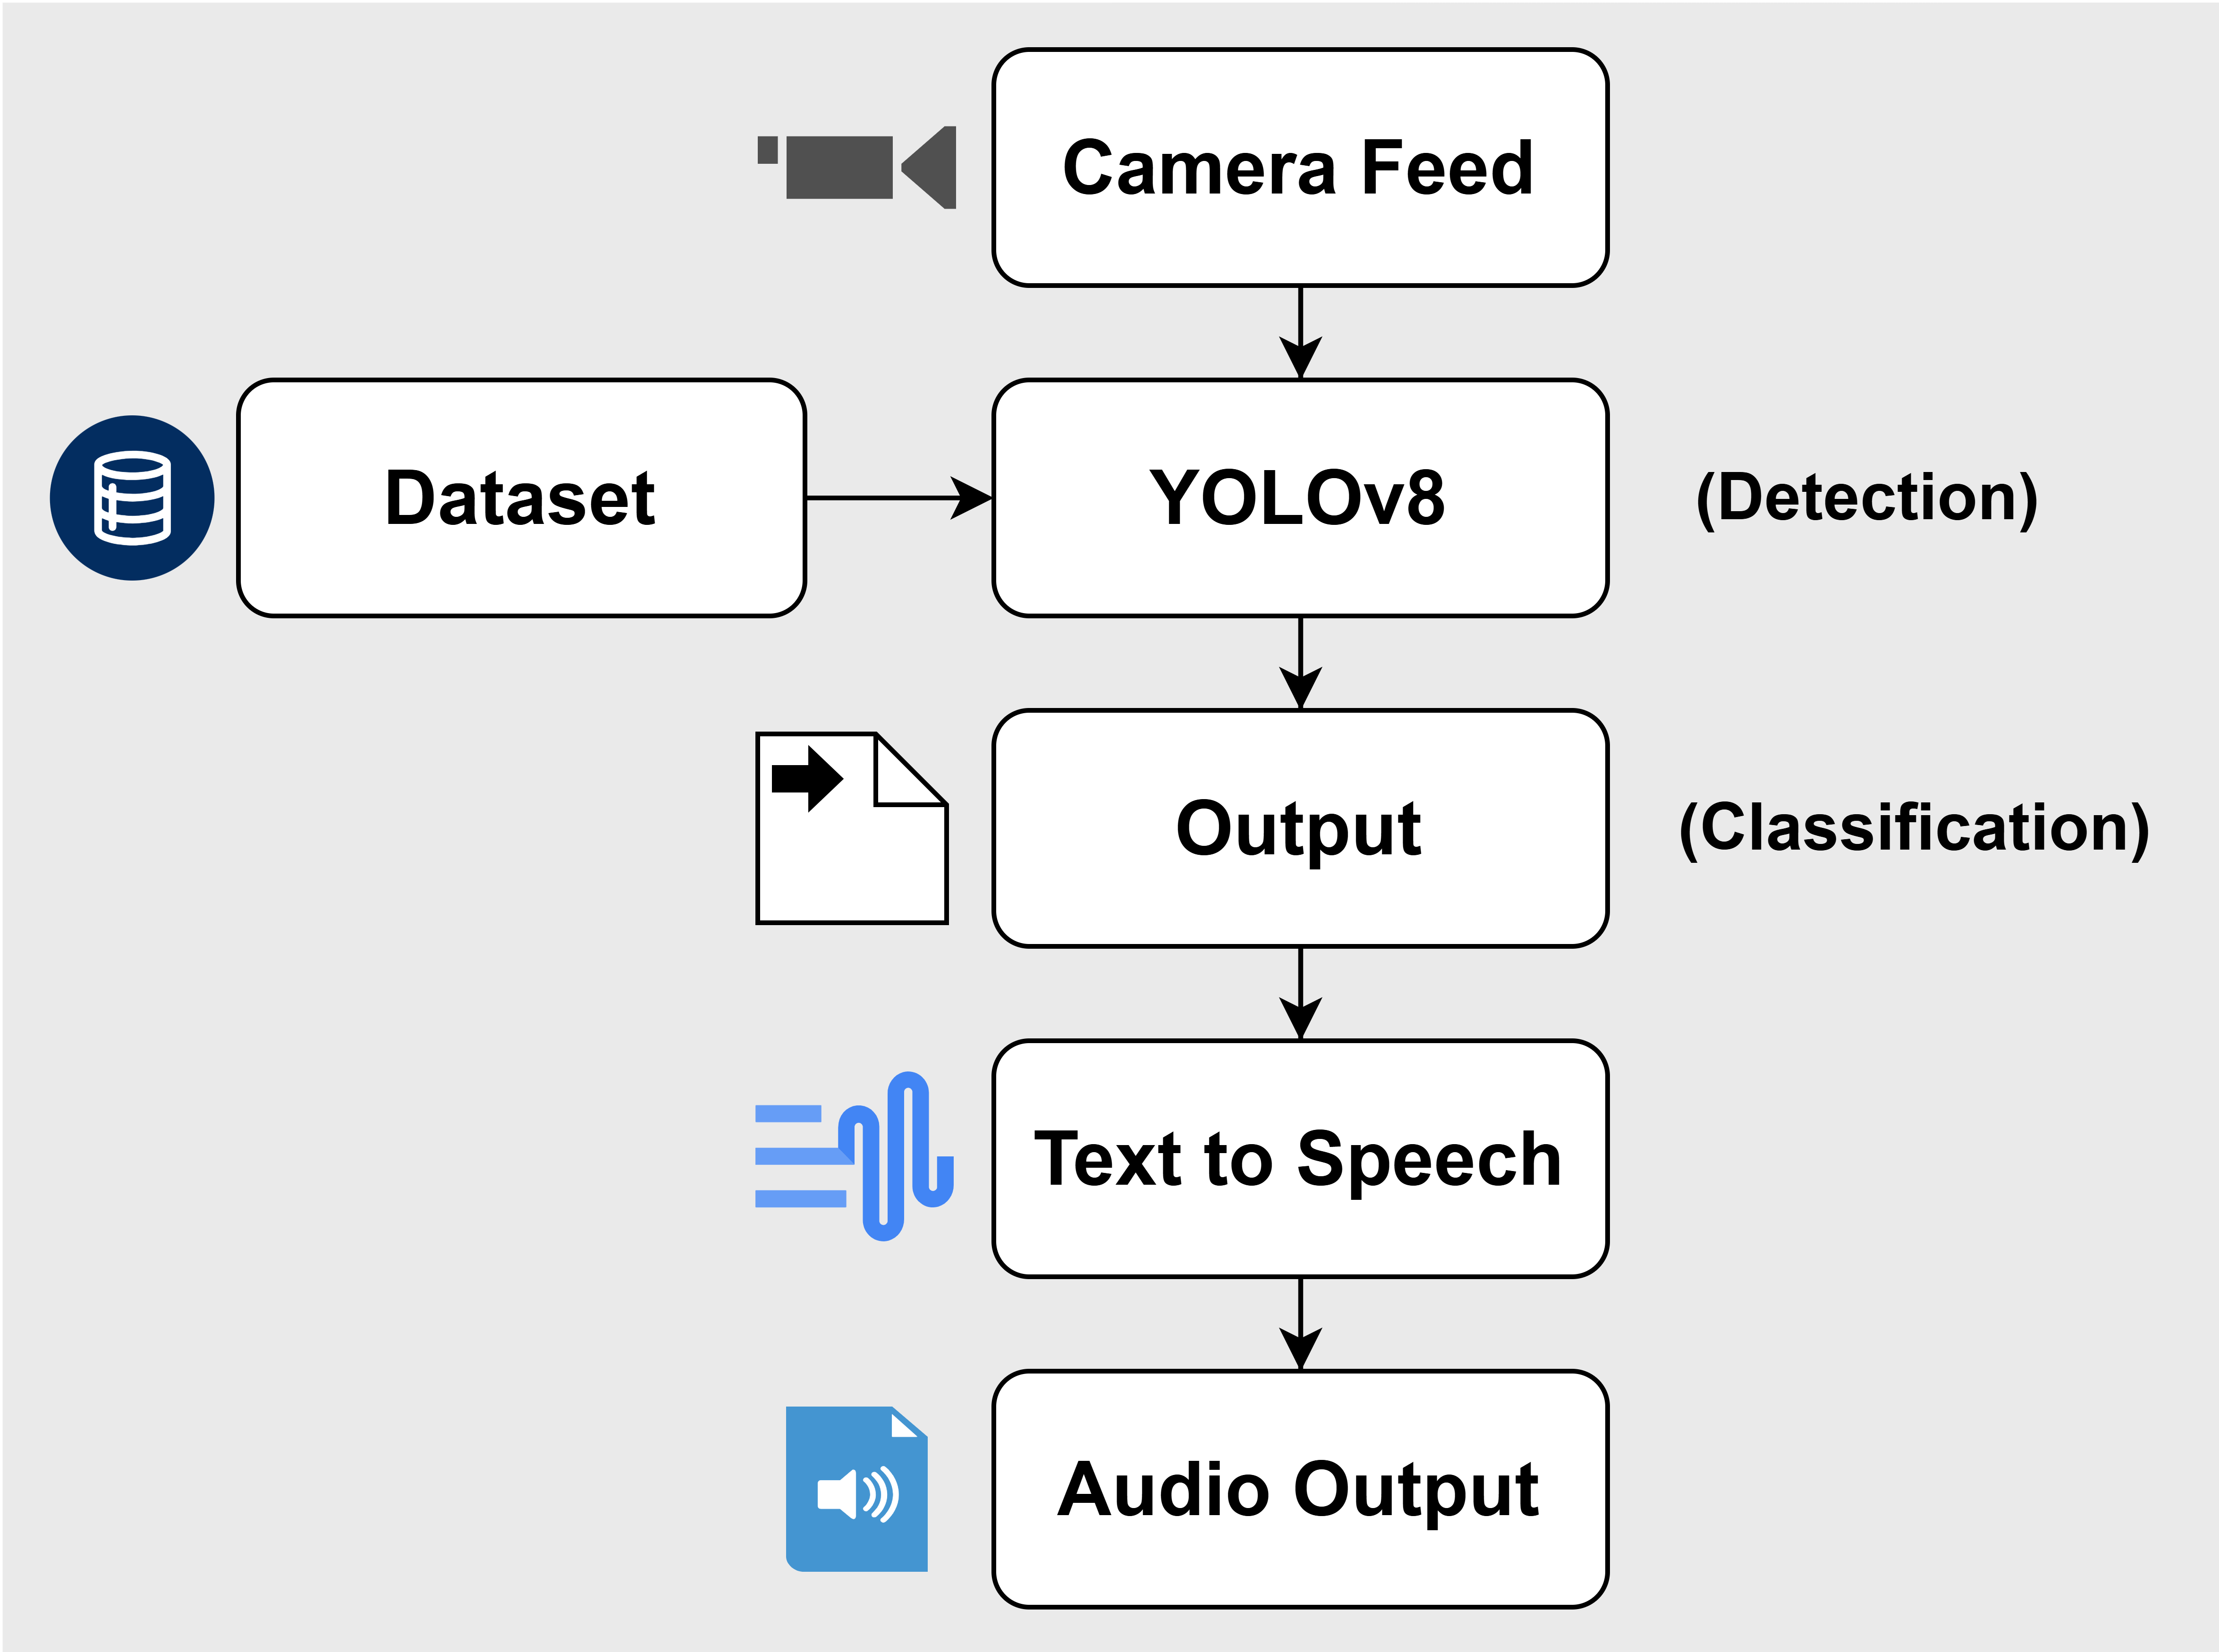



Methodology and Approach
Data Collection and Annotation:
Gather a diverse dataset of road sign images and annotate them, ensuring broad representation for model accuracy across different conditions and sign variations.
Model Selection and Training:
Select suitable computer vision models like YOLO for detection and classification. Train models on the annotated dataset, optimizing for real-time performance in various scenarios.
Voice Feedback Integration:
Implement Text-to-Speech (TTS) technology, such as Google TTS or Python pyttsx3 library, to convert detected sign information into natural, clear voice messages for real-time driver feedback.
Deployment and Maintenance:
Deploy the system in vehicles or traffic management infrastructure. Establish a maintenance plan for updates, bug fixes, and adaptations to new standards.
PCSE25-17

Slide 5




Expected Outcomes and Impact
Enhanced Road Safety:
Efficient Traffic Flow:
User Adoption and Feedback:
The system will improve driver awareness by providing real-time verbal communication of road signs, helping drivers react appropriately and reducing traffic accidents.
By quickly identifying and interpreting road signs, the system will contribute to smoother traffic management, supporting better organization and reducing congestion.
Initial real-world testing will demonstrate drivers’ appreciation for the system, validating its effectiveness and driving further advancements in intelligent transportation networks.
PCSE25-17

Slide 6

Key Project Deliverables
AI Model Development | Training the YOLO v8 model for accurate road sign detection and classification
Text-to-Speech Integration | Converting detected road sign text into audio output for improved driver awareness.
Real-World Testing | Evaluation of the system’s performance in various driving conditions, including day/night and weather.
Project Documentation | Comprehensive report detailing methodology, results, and impact on road safety.
PCSE25-17

Slide 7

Next Steps and Conclusion
Extended Language and Regional Support
1
Performance Optimization
2
Fine-tune YOLO v8 with additional datasets to enhance detection accuracy across varied road signs and conditions.
Experiment with model architectures and augmentations to optimize detection speed and reduce latency for real-time use.
Expand the text-to-speech system to support multiple languages and dialects for global usability.
Integrate region-specific road sign databases to improve system applicability across different countries.
Scaling for Autonomous Driving Systems
3
4
User Adoption and Feedback
Scale the system for autonomous vehicles as part of a broader perception suite.
Integrate road sign detection with other AI safety features for a comprehensive autonomous driving solution.
Initial real-world testing will demonstrate drivers’ appreciation for the system, validating its effectiveness and driving further advancements in intelligent transportation networks.
PCSE25-17

